Slide 1


Transportation Mobility Data Analysis

Slide 2
Table of Content
Introduction
Problem Statement
Dashboard Preview
Primary Research Analysis
Secondary Research Analysis
Recommendation
Conclusions

Slide 3
Introduction :
Goodcabs, a cab service company established two years ago, has gained a strong foothold in the Indian market by focusing on tier-2 cities. Unlike other cab service providers, Goodcabs is committed to supporting local drivers, helping them make a sustainable living in their hometowns while ensuring excellent service to passengers. With operations in yen tier-2 cities across India, Goodcabs has set ambitious performance targets for 2024 to drive growth and improve passenger satisfaction.

Slide 4
Problem Statement :
As part of this initiative, the Goodcabs management team aims to assess the company’s performance across key metrics, including trip volume, passenger satisfaction, repeat passenger rate, trip distribution and the balance between new and repeat passengers.

Slide 5
Dashboard Preview

Slide 6
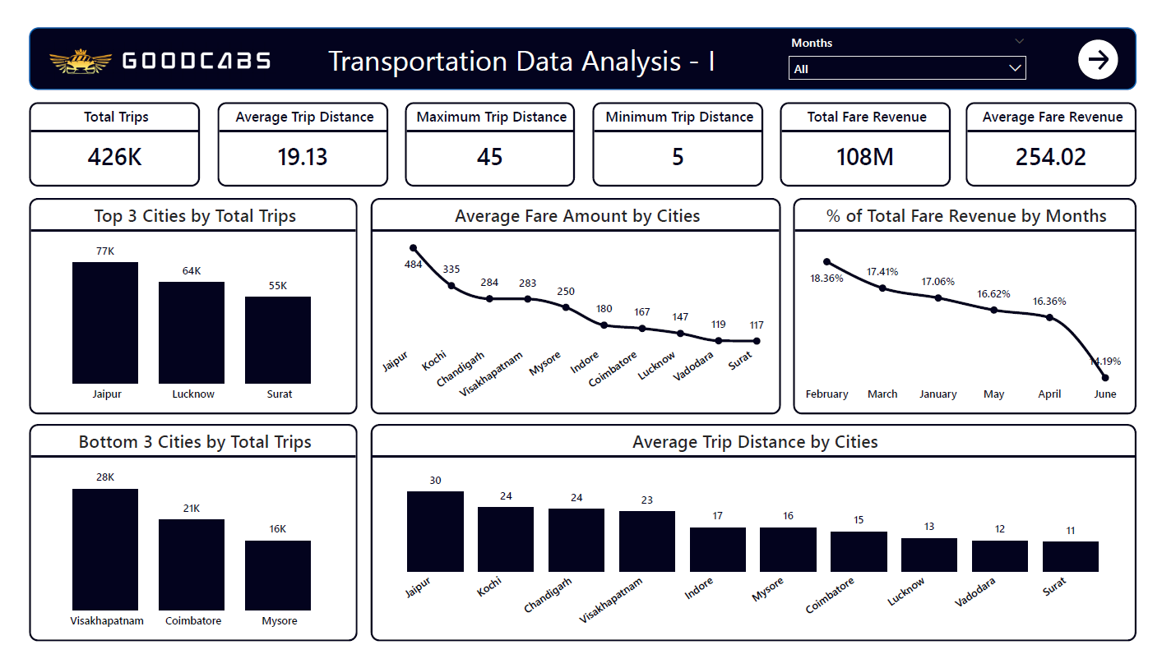

Slide 7
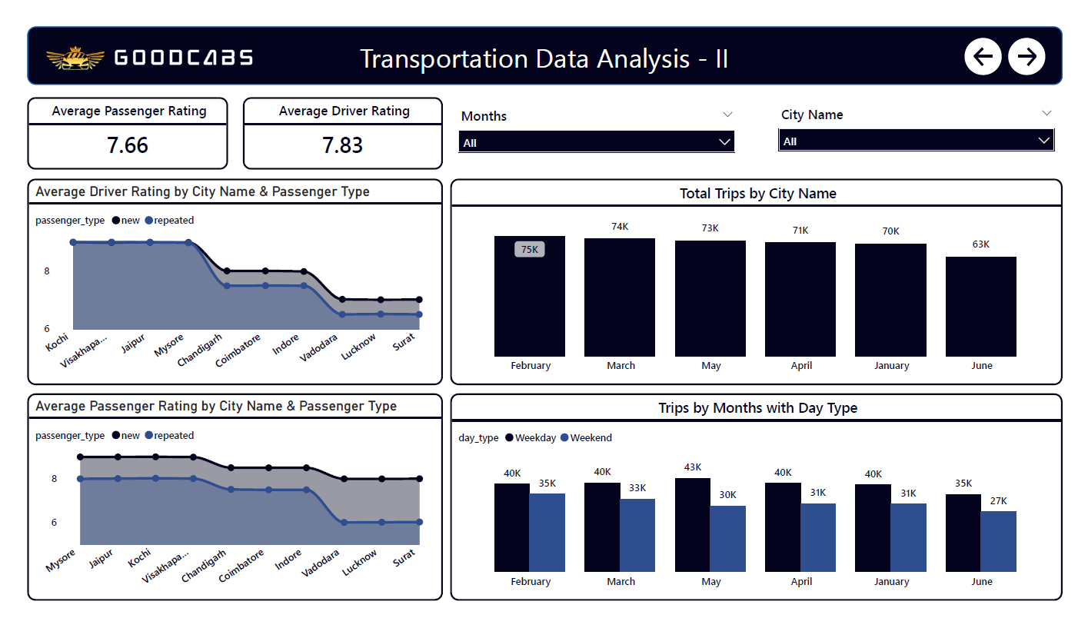

Slide 8
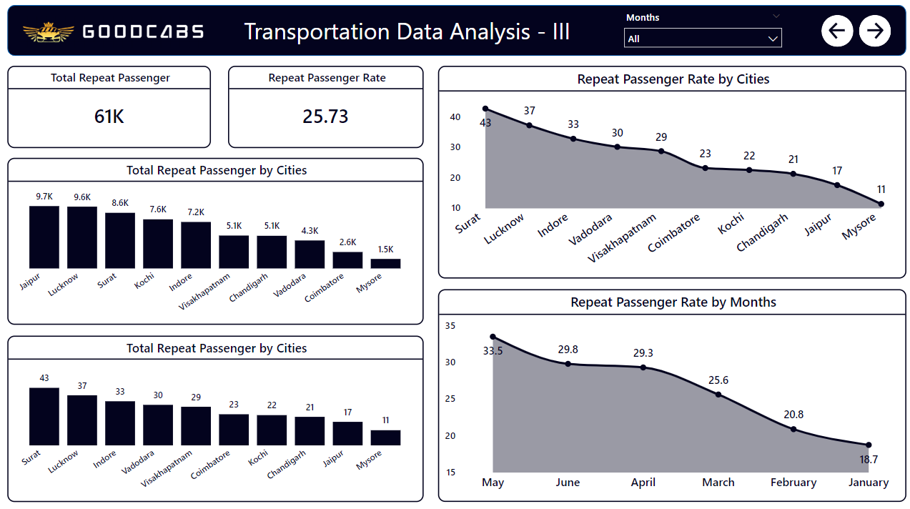

Slide 9
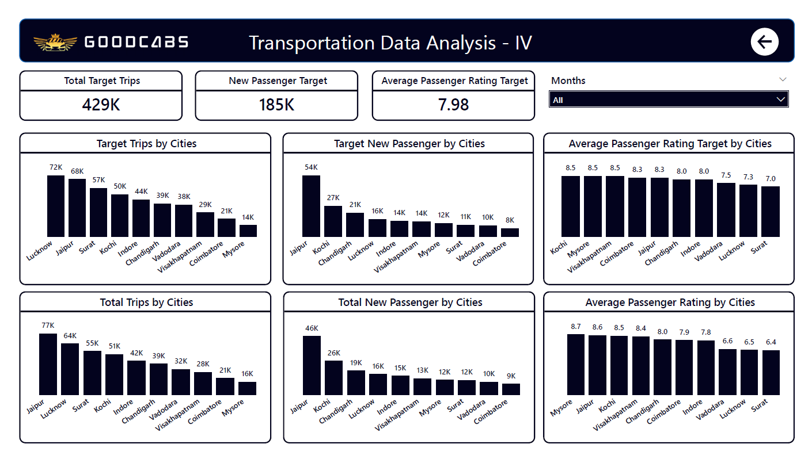

Slide 10
Primary Research Analysis

Slide 11
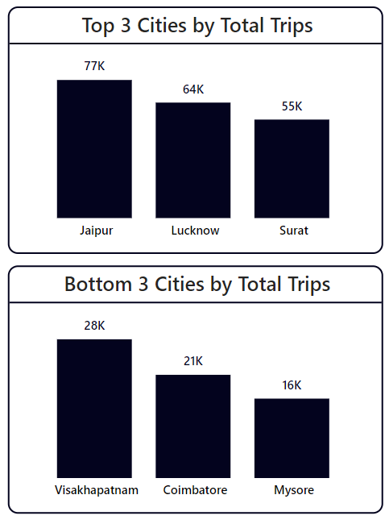
Top & Bottom Performing Cities : Top 3 & Bottom 3 cities by total trips over the entire analysis periods
We can notice that,
Top 3 cities by total trips over the entire analysis periods are : Jaipur, Lucknow and Surat. Here Jaipur had total 77K trips which was the most among all. Then Lucknow and Surat took place with 64K and 55K respectively.
Bottom 3 cities by total trips over the entire analysis periods are : Visakhapatnam, Coimbatore and Mysore. Here Mysore had total 16K trips which was the least among all. Then Coimbatore and Visakhapatnam took place with 21K and 28K respectively.

Slide 12
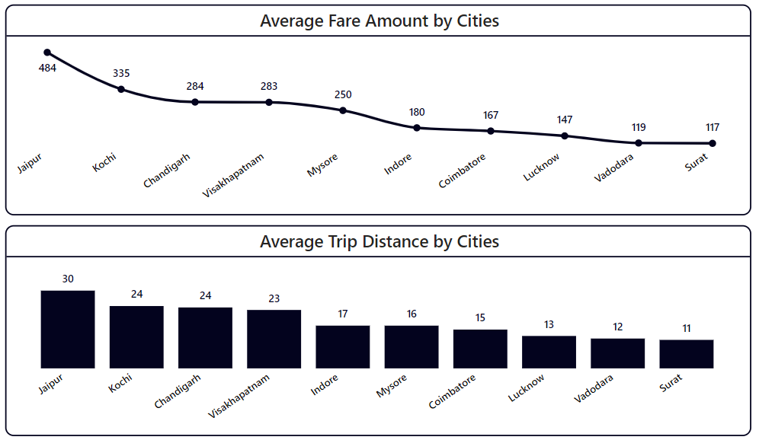
Average Fare per Trip by Cities : Calculate the average fare per trip for each city and compare with the city’s average trip distance. Identify the cities with highest and lowest average fare per trip to assess pricing efficiency across locations
Here average fare amount by cities was depicted. We can notice that, Jaipur has the highest average fare amount, i.e. Rs. 484 and also Jaipur has highest average trip distance i.e. 30 KM.
Where as, Surat has lowest average fare amount, i.e. Rs. 117 and also Surat has lowest average trip distance, i.e. 11 KM.

Slide 13
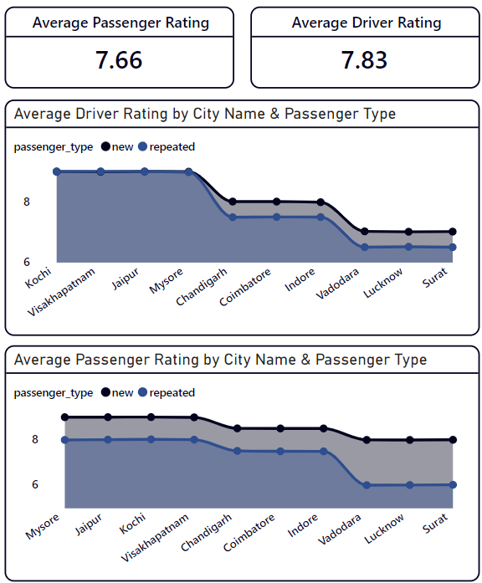
Average Ratings by City & Passenger Types : Calculate the average passenger and driver ratings for each city, segmented by passenger type (new vs. repeat). Identify the cities with highest and lowest average ratings.
Here, overall average passenger rating is 7.66 (of 10) and overall average driver rating is 7.83 (of 10).
According to Driver’s average ratings, Kochi has the highest ratings, i.e. 8.99 (of 10) for “new and repeated” passengers and Surat has the lowest ratings, i.e. 6.99 (of 10) and 6.48 (of 10) for “new” and “repeated” passengers respectively.
According to Passenger’s average ratings, Mysore has the highest ratings, i.e. 8.98 (of 10) for “new” and 7.98 (of 10) for “repeated” and Surat has the lowest ratings, i.e. 7.98 (of 10) and 6.00 (of 10) for “new” and “repeated” passengers respectively.

Slide 14
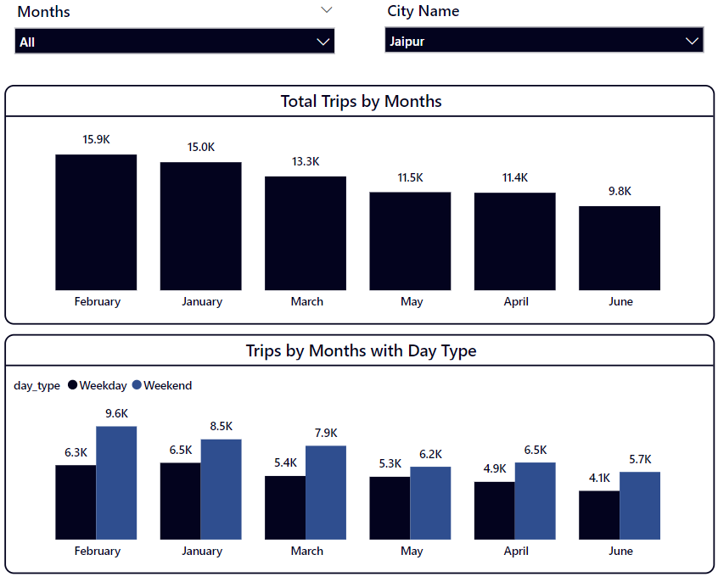
Peak & Low Demand Months by City with Weekend vs Weekday Demand by City :
We can use “City Name” slicer to see each city’s total trips by months and we can see total trips of a month with day types (weekday & weekend).
As example, in Jaipur, February has the highest trips i.e. 15.9K with 6.3K in Weekday and 9.6K in Weekend.
In that way, select other cities to see their records for peak and low demand months.

Slide 15
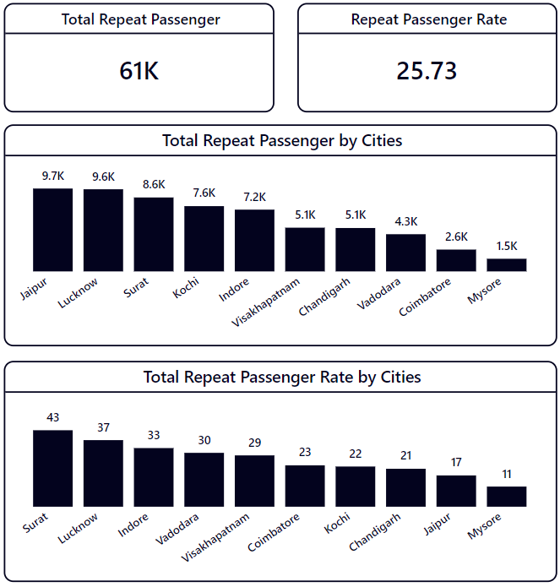
Repeat Passenger Frequency and City Contribution Analysis : Analyze the frequency of trips taken by repeat passengers in each city
We can observe the total repeat passengers are 61K and the total repeat passenger rate is 25.73% in all cities.
Jaipur has the highest number of total repeat passengers, i.e. 9.7K, where as, in Mysore, it is the lowest, i.e. 1.5K
In Surat, total repeat passenger rate is 43% which is highest, where as, in Mysore, it is only 11%.
Here from the analysis, we conclude that, as a popular tourist place Jaipur has highest repeat passenger count, while as a popular business place, Surat has highest repeat passenger rate.

Slide 16
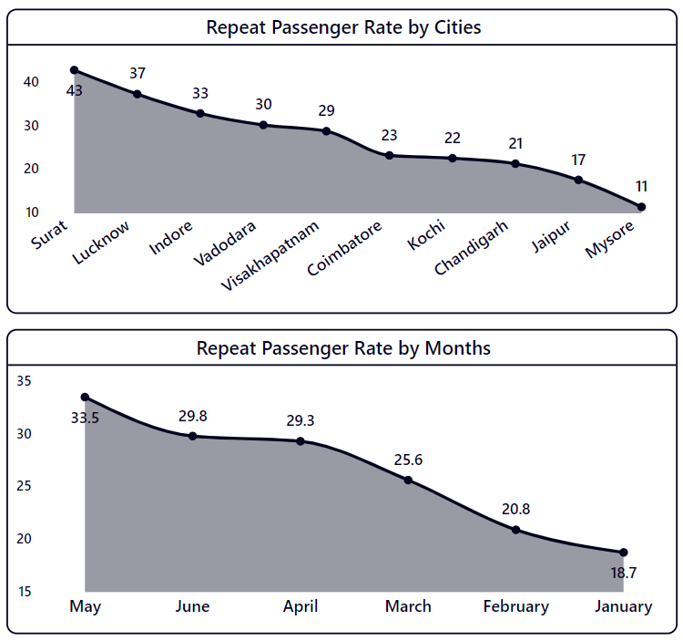
Highest & Lowest Repeat Passenger Rate by City and Months :
We can observe that, Surat has the highest repeat passenger rate among all cities, i.e. 43%. Where as, Mysore has the lowest repeat passenger rate, i.e. 11%
According to months, the highest repeat passenger rate 33.5% obtained by May. Where as, the lowest repeat passenger rate 18.7% obtained by January.

Slide 17

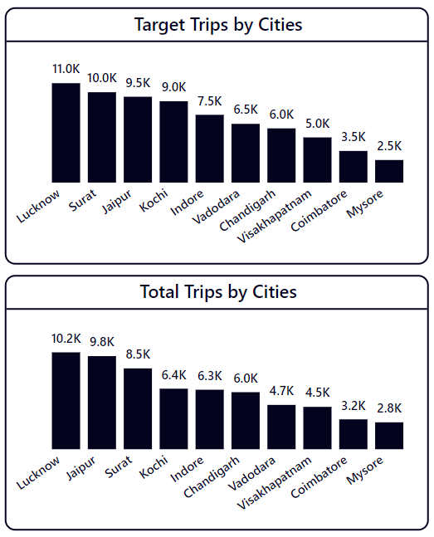
Monthly Target Achievement Analysis for Key Metrics : Part - I
Here, we use Months slicer to select the desired month to observe the total trips and target trips by cities in that particular month.
We have selected ‘June’ as month, and we can see in Lucknow highest total trips occurred, i.e. 10.2K, but our target trips was 11.0K, we have missed the target slightly.
If we observe Jaipur, our total trips 9.8K, but our target trips was 9.5K, which was brilliant and we exceeded the target line.
In this way, we can analyze others city’s data here.

Slide 18
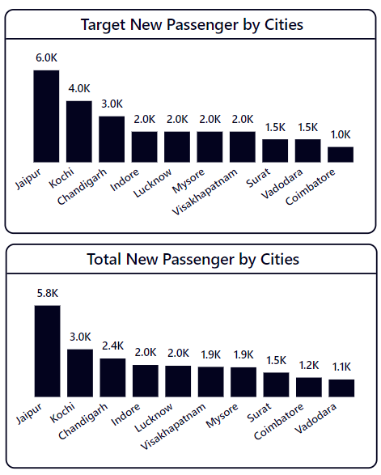
Monthly Target Achievement Analysis for Key Metrics : Part - II
Here, we use Months slicer to select the desired month to observe the total new passenger and target passengers by cities in that particular month.
We have selected ‘June’ as month, and we can see in Jaipur highest total passenger count, i.e. 5.8K, but our target passenger count was 6.0K, we have missed the target slightly.
If we observe Mysore, our total passenger count 1.9K, but our target passenger count was 2.0K, which was brilliant and we exceeded the target line.
In this way, we can analyze others city’s data here.

Slide 19
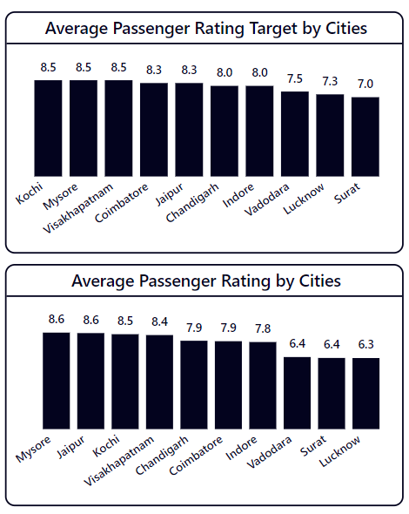
Monthly Target Achievement Analysis for Key Metrics : Part - III
Here, we use Months slicer to select the desired month to observe the average passenger rating and target passenger rating by cities in that particular month.
We have selected ‘June’ as month, and we can see in Mysore highest average passenger rating, i.e. 8.6, but our target average passenger rating was 8.5, we have achieved the target slightly.
If we observe Lucknow, our average passenger rating 6.3, but our target average passenger rating was 7.3, which was not good and we missed the target line.
In this way, we can analyze others city’s data here.

Slide 20
Secondary Research Analysis

Slide 21
Factors Influencing Repeat Passenger Rate : What factors (such as quality of service, competitive pricing, or city demographics) might contribute to higher and lower repeat passenger rates in different cities ? Are there correlations with socioeconomic or lifestyle patterns in these cities ?
>>> There are many factors which might contribute to higher and lower passenger rates in different cities, which are quality of services, pricing pattern according to distance travelled and demographics of the cities.
As example, Jaipur is capital of Rajasthan and also a popular tourist spot. So, we can expect that here the mobility availability is much efficient and also cost will be high due to tourist spot. In the same way Chandigarh, Indore are also capitals of their states.
Besides this, socio-economic condition and lifestyle matter for taking rides of private cabs. If socio-economic rate is not high in some cities, then taking rent of cabs will much lesser.

Slide 22
Tourism vs Business Demand Impact : how do tourism season or local events (festivals, conferences) impact goodcabs demand patterns ? Would tailoring marketing efforts to these events increase trip volume in tourism-oriented cities ?
>>> The seasons of tourism and local events like festivals and big conferences may impact a lot in demand patterns of goodcabs services. During the peak season of tourism and festivals, people need transport in high demand for visiting the places and many people preferred private taxi service for smooth transportation and less traffic impact.
Of course, marketing events in tourism-oriented cities will increase the trip volume drastically during the peak season of the cities.

Slide 23
Emerging Mobility Trends and Goodcabs’ Adaptation : What emerging mobility trends (such as electric vehicle adaptation, green energy use) are impacting the cab service market in tier-2 cities ? Should Goodcabs consider integrating electric vehicles or eco-friendly initiatives to stay competitive ?
>>> In recent worlds, electric vehicle adaptation in trend and in many sector adapting green energy to stay competitive in market. In that way, Goodcabs should bring the electric vehicle adaptation to make solid impact in cab service industry in those tier-2 cities.
Eco-friendly electric service will keep positive impact widely for this cab service sector. Though, integrating electric vehicles are also providing good impact in many areas. But firstly, we should take a look for the customer’s needs, if it needed in any particular city then Goodcabs may implement the integrating electric vehicles or eco-friendly initiative.

Slide 24
Partnership Opportunities with Local Business : Are these opportunities for Goodcabs to partner with local businesses (such as hotels, malls and event venues) to boost demand and improve customer loyalty ? Could these partnership drive more traffics, specially in tourism-heavy or high footfall areas ?
>>> The tie up with local businesses are always become beneficial foe both local businesses and cab services. Here two business sector will be dependent with each other. Goodcabs will beneficial specially when customer or tourist come to stay hotels, they will sight seeing with Goodcabs services and also they may visit shopping mall using Goodcabs car if they tie up with shopping mall and during any large event in city, people will use Goodcabs while they see that the event partner is Goodcabs, then they will prefer to use Goodcabs for reaching the destination.
If they do partnership with as hotels, malls and event venues, then obviously these partnership drive more traffics, specially in tourism-heavy or high footfall areas due to above mentioned possibilities.

Slide 25
Data Collection for Enhanced Data Driven Decision : To makes Goodcabs more data-driven and improve it’s performance across key metrics (such as repeat passenger rate, customer satisfaction, new passengers and trip volume), what additional data should Goodcabs collect ? Consider data that could provide deeper insights into customer behaviour, operational efficiency and market trends.
>>> Some data that may improve it’s performance more due to more understanding about passenger’s behaviour like which area of a city they prefer most to book trips. So, we may take the latitude and longitude to know the exact location of a city and when we find some particular location has high demand for booking Goodcabs, then we should increase cabs in that area for always availability for passengers. In this way, waiting time for passengers will be less and they will reach their destination on time. Also, when passenger will find that Goodcabs are easily accessible, they will turn back from other competitors and will recommend Goodcabs for future ride.

Slide 26



Goodcab’s Iconic Ambasssdors
Virat Kohli
Shreya Ghoshal
Mahesh Babu

Slide 27
Recommendations for Goodcabs
Focus on More Cities : Goodcabs should focus on more cities of other states, like New Delhi, Mumbai, Bengaluru, Kolkata. These 4 cities are top metropolitan cities of India. If in those cities Goodcabs provide good services, then revenues will increase drastically and Goodcabs will be known broadly across the India.
Take Government Subsidies for EV Market : In the new era of green energy and electric vehicle, Goodcabs should deep dive into EV world and firstly take incentives and subsidies from Government of India. It will become more fruitful for Goodcabs to easily penetrate into EV sector and passengers will also satisfy when they will know Goodcabs providing EV services with help of Government of India.

Slide 28
Conclusion
Goodcabs is poised to expand its presence in other states and cities from our comprehensive marketing analysis. The research highlights significant opportunities in several cities with new launch of EV cab services. To grow on these findings, Goodcabs should focus on :
Launching in strategically selected cities with proven market demand.
Expanding partnership with local hotels, mall and events organizers.
Utilizing Government incentives and subsidies to bring the EV cab services in market.
By following these strategies, Goodcabs can established a strong impact on cab service market, align with customer needs and achieve sustainable growth in industry.

Slide 29
THANK
YOU

